Slide 1
Logistic Regression Deploy Score Code

Slide 2
Simple Example

Slide 3
MODEL DEPLOYMENT: Simple Example
This example is taken from the previously mentioned Draper and Smith reference.
The data describes monthly steam usage in a manufacturing plant
Y Monthly use of steam
X6 Operating days per month
X8 Average temperature in degrees Fahrenheit
NOTE: Draper and Smith named their variables X6 and X8, don’t worry about that. The names of the variables are not important and don’t affect the formula.
Raw Data is given on the following slide.
SAS Code is provided to read data into SAS

Slide 4
MODEL DEPLOYMENT: Simple Example
Raw Steam Usage Data
 | X6 | X8 | Y
1 | 20 | 35.3 | 10.98
2 | 20 | 29.7 | 11.13
3 | 23 | 30.8 | 12.51
4 | 20 | 58.8 | 8.4
5 | 21 | 61.4 | 9.27
6 | 22 | 71.3 | 8.73
7 | 11 | 74.4 | 6.36
8 | 23 | 76.7 | 8.5
9 | 21 | 70.7 | 7.82
10 | 20 | 57.5 | 9.14
11 | 20 | 46.4 | 8.24
12 | 21 | 28.9 | 12.19
13 | 21 | 28.1 | 11.88
14 | 19 | 39.1 | 9.57
15 | 23 | 46.8 | 10.94
16 | 20 | 48.5 | 9.58
17 | 22 | 59.3 | 10.09
18 | 22 | 70 | 8.11
19 | 11 | 70 | 6.83
20 | 23 | 74.5 | 8.88
21 | 20 | 72.1 | 7.68
22 | 21 | 58.1 | 8.47
23 | 20 | 44.6 | 8.86
24 | 20 | 33.4 | 10.36
25 | 22 | 28.6 | 11.08

Slide 5
MODEL DEPLOYMENT: Simple Example
SAS Data Step to read in raw data
(notice that “Y” needs to be converted into a binary variable (0,1)
data TEMPFILE;
input X6 X8 Y;
Y = (Y>10);
datalines;
20 35.3 10.98
20 29.7 11.13
23 30.8 12.51
20 58.8 8.40
21 61.4 9.27
22 71.3 8.73
11 74.4 6.36
23 76.7 8.50
21 70.7 7.82
20 57.5 9.14
20 46.4 8.24
21 28.9 12.19
21 28.1 11.88
19 39.1 9.57
23 46.8 10.94
20 48.5 9.58
22 59.3 10.09
22 70.0 8.11
11 70.0 6.83
23 74.5 8.88
20 72.1 7.68
21 58.1 8.47
20 44.6 8.86
20 33.4 10.36
22 28.6 11.08
;
run;

Slide 6
MODEL DEPLOYMENT: Simple Example
Raw Steam Usage Data (with the target Y converted to a Binary value)
 | X6 | X8 | Y
1 | 20 | 35.3 | 1
2 | 20 | 29.7 | 1
3 | 23 | 30.8 | 1
4 | 20 | 58.8 | 0
5 | 21 | 61.4 | 0
6 | 22 | 71.3 | 0
7 | 11 | 74.4 | 0
8 | 23 | 76.7 | 0
9 | 21 | 70.7 | 0
10 | 20 | 57.5 | 0
11 | 20 | 46.4 | 0
12 | 21 | 28.9 | 1
13 | 21 | 28.1 | 1
14 | 19 | 39.1 | 0
15 | 23 | 46.8 | 1
16 | 20 | 48.5 | 0
17 | 22 | 59.3 | 1
18 | 22 | 70 | 0
19 | 11 | 70 | 0
20 | 23 | 74.5 | 0
21 | 20 | 72.1 | 0
22 | 21 | 58.1 | 0
23 | 20 | 44.6 | 0
24 | 20 | 33.4 | 1
25 | 22 | 28.6 | 1

Slide 7
Simple Example
Logistic Regression REF=“0”

Slide 8
Logistic Regression REF=“0”
SAS has many procs that can do Logistic Regression. PROC LOGISTIC is one of them.
PROC LOGISTIC (Logistic Regression)
REF=“0” means that PROC LOGISTIC will compute the probability that Y=1
proc logistic data=TEMPFILE;
model Y(ref=“0”) = X6 X8;
run;
quit;

Slide 9
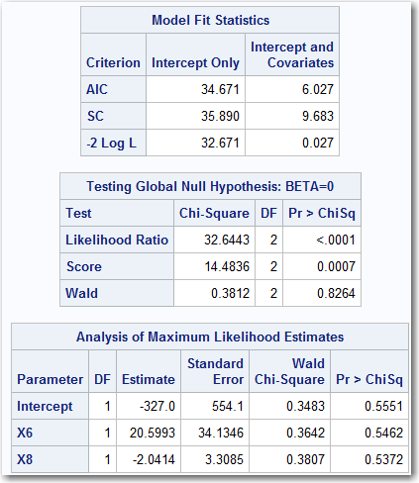
Logistic Regression REF=“0”
Here are the results from PROC LOGIT (REF=“0”)

Slide 10
Logistic Regression REF=“0”
Here are the results from PROC LOGIT (REF=“0”)
Beta Values

Slide 11
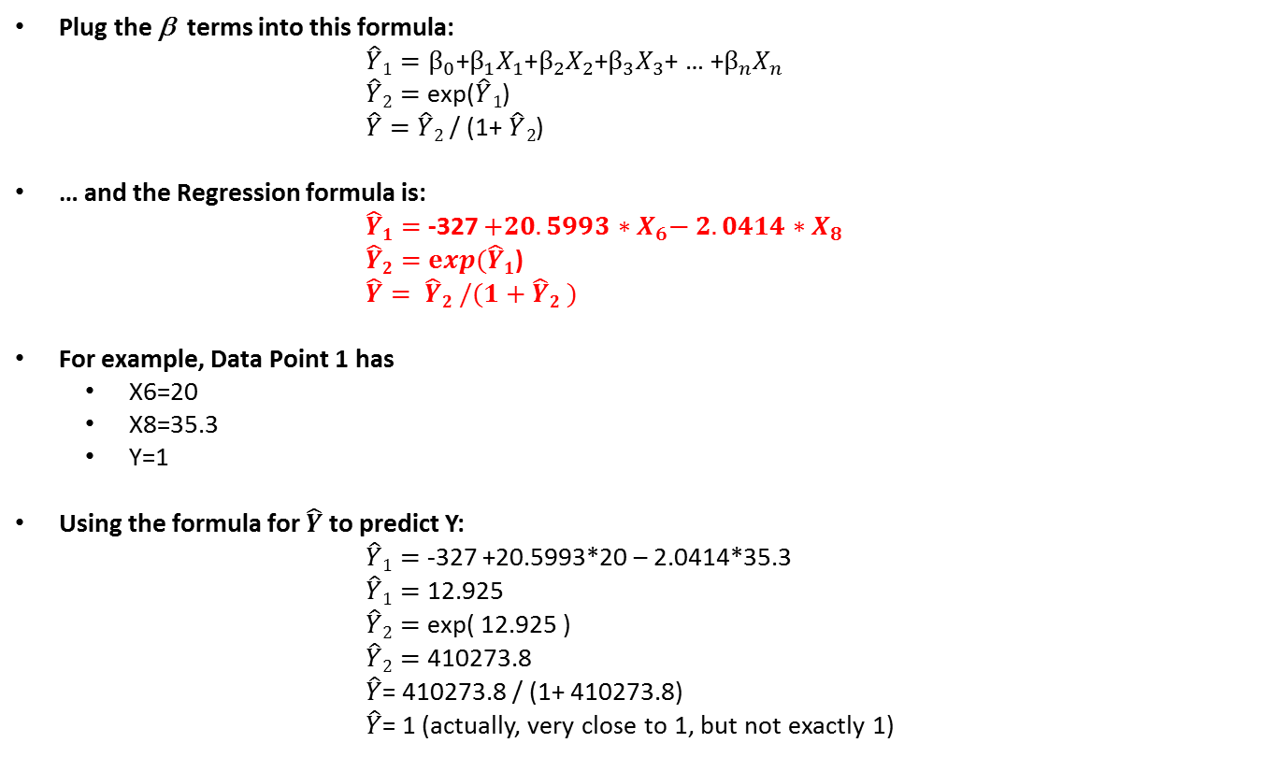
Logistic Regression REF=“0”
Plug the β terms into this formula:
$\hat{Y}1=β_{0}$+$β_{1}X_{1}\text{+}β_{2}X_{2}$+$β_{3}X_{3}$+ … +$β_{n}X_{n}$
$\hat{Y}2=$ exp($\hat{Y}1$)
$\hat{Y}=$ $\hat{Y}2$ / (1+ $\hat{Y}2$)
… and the Regression formula is:
$\hat{Y}1=$ -327 $+20.5993{ ∗X}_{6}\text{−} 2.0414∗X_{8}$
$\hat{Y}2=$ $exp(\hat{Y}1$)
$\hat{Y}= \hat{Y}2$ $/(1+\hat{Y}2$ $)$
For example, Data Point 1 has
X6=20
X8=35.3
Y=1
Using the formula for $\hat{Y}$ to predict Y:
$\hat{Y}1=$ -327 +20.5993*20 – 2.0414*35.3
$\hat{Y}1=$ 12.925
$\hat{Y}2=$ exp( 12.925 )
$\hat{Y}2=$ 410273.8
$\hat{Y}$= 410273.8 / (1+ 410273.8)
$\hat{Y}$= 1 (actually, very close to 1, but not exactly 1)

Slide 12
Logistic Regression REF=“0”
A SAS Data Step can score new data using the results from the Regression. Here is what the Data Step might look like.
data NEWFILE;
set TEMPFILE;
TEMP = -327 + 20.5993*X6 – 2.0414*X8;
TEMP = exp( TEMP );
TEMP = TEMP / (1.0+TEMP);
Y_Hat_Logit_0 = TEMP;
drop TEMP;
run;
To use this Data Step, simply replace “TEMPFILE” with the name of your file. The results will be stored in a data set called “NEWFILE”.
This is simple enough, but to make this more general purpose, it would be easy to put this Data Step inside of a SAS Macro.

Slide 13
Logistic Regression REF=“0”
The Data Step is now contained in a SAS Macro:
%macro SCORE( INFILE, OUTFILE );
data &OUTFILE.;
set &INFILE.;
TEMP = -327 + 20.5993*X6 – 2.0414*X8;
TEMP = exp( TEMP );
TEMP = TEMP / (1.0+TEMP);
Y_Hat_Logit_0 = TEMP;
drop TEMP;
run;
%mend;
When you call the SAS Macro, pass it the name of the data set and a name of a new data set where you want to store the results.
%SCORE( TEMPFILE, MY_NEW_FILE );

Slide 14
Logistic Regression REF=“0”
The output of the proc print would be:
Obs | X6 | X8 | Y | Y_Hat_Logit_0
1 | 20 | 35.3 | 1 | 1
2 | 20 | 29.7 | 1 | 1
3 | 23 | 30.8 | 1 | 1
4 | 20 | 58.8 | 0 | 0
5 | 21 | 61.4 | 0 | 0
6 | 22 | 71.3 | 0 | 0
7 | 11 | 74.4 | 0 | 0
8 | 23 | 76.7 | 0 | 0.00006
9 | 21 | 70.7 | 0 | 0
10 | 20 | 57.5 | 0 | 0
11 | 20 | 46.4 | 0 | 0.00006
12 | 21 | 28.9 | 1 | 1
13 | 21 | 28.1 | 1 | 1
14 | 19 | 39.1 | 0 | 0
15 | 23 | 46.8 | 1 | 1
16 | 20 | 48.5 | 0 | 0
17 | 22 | 59.3 | 1 | 0.99412
18 | 22 | 70 | 0 | 0
19 | 11 | 70 | 0 | 0
20 | 23 | 74.5 | 0 | 0.00496
21 | 20 | 72.1 | 0 | 0
22 | 21 | 58.1 | 0 | 0
23 | 20 | 44.6 | 0 | 0.00233
24 | 20 | 33.4 | 1 | 1
25 | 22 | 28.6 | 1 | 1

Slide 15
Logistic Regression REF=“0”
Now it is possible to predict the “Y” value for new input values. For example:
data SomeNewData;
input X6 X8;
datalines;
15 25
20 35
25 45
30 50
35 55
;
run;
%SCORE(SomeNewData, NowItsScored );
proc print data=NowItsScored;
run;

Slide 16
Logistic Regression REF=“0”
The output of the proc print would be:
Obs | X6 | X8 | Y_Hat_Logit_0
1 | 15 | 25 | 0
2 | 20 | 35 | 1
3 | 25 | 45 | 1
4 | 30 | 50 | 1
5 | 35 | 55 | 1

Slide 17
Simple Example
Logistic Regression REF=“1”

Slide 18
Logistic Regression REF=“1”
SAS has many procs that can do Logistic Regression. PROC LOGISTIC is one of them.
PROC LOGISTIC (Logistic Regression)
REF=“1” means that PROC LOGISTIC will compute the probability that Y=0
proc logistic data=TEMPFILE;
model Y(ref=“1”) = X6 X8;
run;
quit;

Slide 19
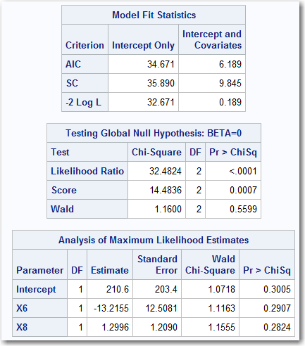
Logistic Regression REF=“1”
Here are the results from PROC LOGIT (REF=“1”)

Slide 20
Logistic Regression REF=“1”
Here are the results from PROC LOGIT (REF=“1”)
Beta Values

Slide 21
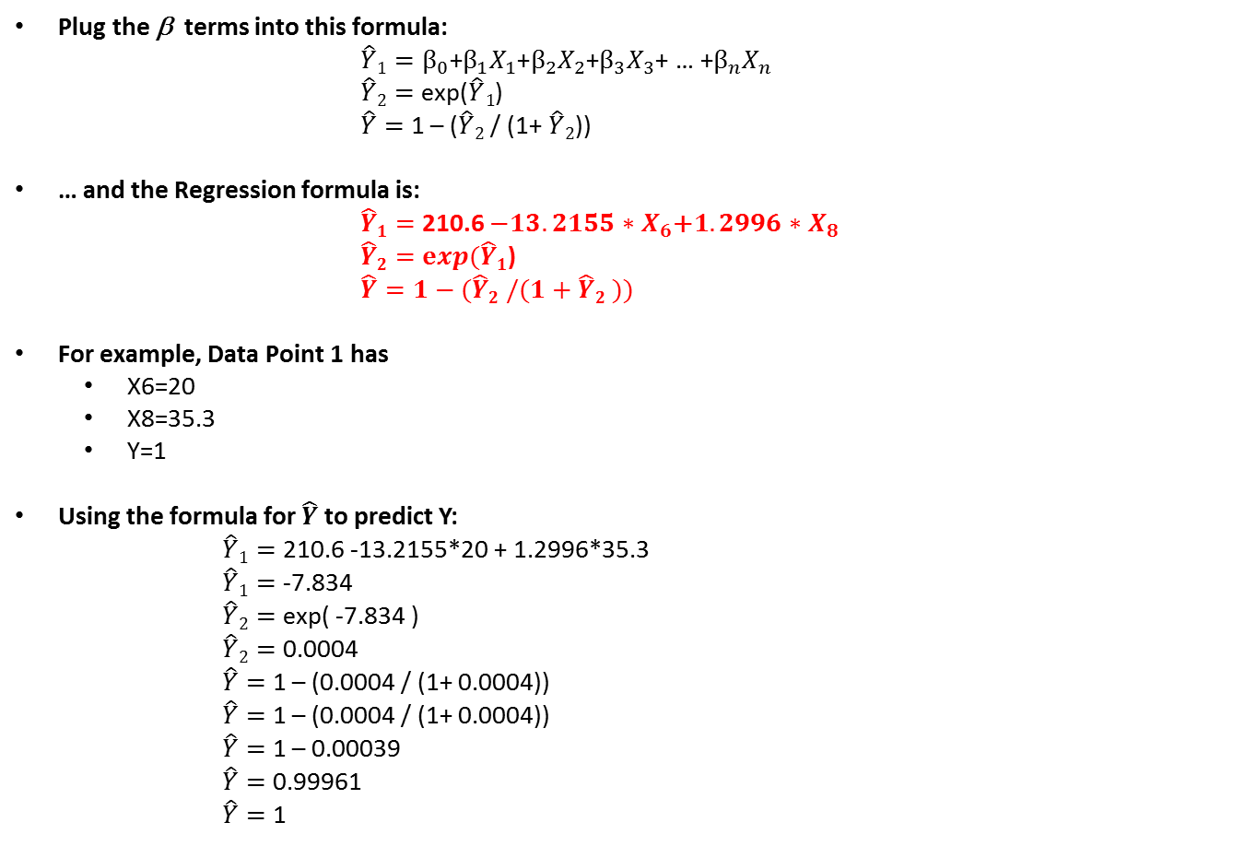
Logistic Regression REF=“1”
Plug the β terms into this formula:
$\hat{Y}1=β_{0}$+$β_{1}X_{1}\text{+}β_{2}X_{2}$+$β_{3}X_{3}$+ … +$β_{n}X_{n}$
$\hat{Y}2=$ exp($\hat{Y}1$)
$\hat{Y}=$ 1 – ($\hat{Y}2$ / (1+ $\hat{Y}2$))
… and the Regression formula is:
$\hat{Y}1=$ 210.6 $−13.2155{ ∗X}_{6}\text{+}1.2996∗X_{8}$
$\hat{Y}2=$ $exp(\hat{Y}1$)
$\hat{Y}=1−(\hat{Y}2$ $/(1+\hat{Y}2$ $))$
For example, Data Point 1 has
X6=20
X8=35.3
Y=1
Using the formula for $\hat{Y}$ to predict Y:
$\hat{Y}1=$ 210.6 -13.2155*20 + 1.2996*35.3
$\hat{Y}1=$ -7.834
$\hat{Y}2=$ exp( -7.834 )
$\hat{Y}2=$ 0.0004
$\hat{Y}=$ 1 – (0.0004 / (1+ 0.0004))
$\hat{Y}=$ 1 – (0.0004 / (1+ 0.0004))
$\hat{Y}=$ 1 – 0.00039
$\hat{Y}=$ 0.99961
$\hat{Y}=$ 1

Slide 22
Logistic Regression REF=“1”
A SAS Data Step can score new data using the results from the Regression. Here is what the Data Step might look like.
data NEWFILE;
set TEMPFILE;
TEMP = 210.6 – 13.2155*X6 + 1.2996*X8;
TEMP = exp( TEMP );
TEMP = TEMP / (1.0+TEMP);
TEMP = 1-TEMP;
Y_Hat_Logit_1 = TEMP;
drop TEMP;
run;
To use this Data Step, simply replace “TEMPFILE” with the name of your file. The results will be stored in a data set called “NEWFILE”.
This is simple enough, but to make this more general purpose, it would be easy to put this Data Step inside of a SAS Macro.

Slide 23
Logistic Regression REF=“1”
The Data Step is now contained in a SAS Macro:
%macro SCORE( INFILE, OUTFILE );
data &OUTFILE.;
set &INFILE.;
TEMP = 210.6 – 13.2155*X6 + 1.2996*X8;
TEMP = exp( TEMP );
TEMP = TEMP / (1.0+TEMP);
TEMP = 1-TEMP;
Y_Hat_Logit_1 = TEMP;
drop TEMP;
run;
%mend;
When you call the SAS Macro, pass it the name of the data set and a name of a new data set where you want to store the results.
%SCORE( TEMPFILE, MY_NEW_FILE );

Slide 24
Logistic Regression REF=“1”
The output of the proc print would be:
Obs | X6 | X8 | Y | Y_Hat_Logit_1
1 | 20 | 35.3 | 1 | 0.9996
2 | 20 | 29.7 | 1 | 1
3 | 23 | 30.8 | 1 | 1
4 | 20 | 58.8 | 0 | 0
5 | 21 | 61.4 | 0 | 0
6 | 22 | 71.3 | 0 | 0
7 | 11 | 74.4 | 0 | 0
8 | 23 | 76.7 | 0 | 0.00179
9 | 21 | 70.7 | 0 | 0
10 | 20 | 57.5 | 0 | 0
11 | 20 | 46.4 | 0 | 0.00137
12 | 21 | 28.9 | 1 | 1
13 | 21 | 28.1 | 1 | 1
14 | 19 | 39.1 | 0 | 0.00003
15 | 23 | 46.8 | 1 | 1
16 | 20 | 48.5 | 0 | 0.00009
17 | 22 | 59.3 | 1 | 0.95584
18 | 22 | 70 | 0 | 0.00002
19 | 11 | 70 | 0 | 0
20 | 23 | 74.5 | 0 | 0.03036
21 | 20 | 72.1 | 0 | 0
22 | 21 | 58.1 | 0 | 0.00019
23 | 20 | 44.6 | 0 | 0.01403
24 | 20 | 33.4 | 1 | 0.99997
25 | 22 | 28.6 | 1 | 1

Slide 25
Logistic Regression REF=“1”
Now it is possible to predict the “Y” value for new input values. For example:
data SomeNewData;
input X6 X8;
datalines;
15 25
20 35
25 45
30 50
35 55
;
run;
%SCORE(SomeNewData, NowItsScored );
proc print data=NowItsScored;
run;

Slide 26
Logistic Regression REF=“1”
The output of the proc print would be:
Obs | X6 | X8 | Y_Hat_Logit_1
1 | 15 | 25 | 0
2 | 20 | 35 | 0.99973
3 | 25 | 45 | 1
4 | 30 | 50 | 1
5 | 35 | 55 | 1

Slide 27
Simple Example
Probit Regression REF=“0”

Slide 28
Probit Regression REF=“0”
SAS has many procs that can do Logistic Regression. PROC LOGISTIC is one of them.
PROC LOGISTIC (PROBIT Regression)
REF=“0” means that PROC LOGISTIC will compute the probability that Y=1
/LINK=PROBIT means that PROC LOGISTIC will compute a PROBIT regression
proc logistic data=TEMPFILE;
model Y(ref=“0”) = X6 X8 /link=probit;
run;
quit;

Slide 29
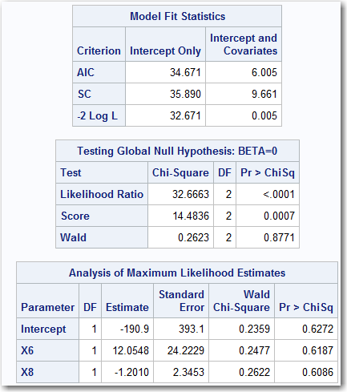
Probit Regression REF=“0”
Here are the results from PROC LOGIT /PROBIT (REF=“0”)

Slide 30
Probit Regression REF=“0”
Here are the results from PROC LOGIT /PROBIT (REF=“0”)
Beta Values

Slide 31
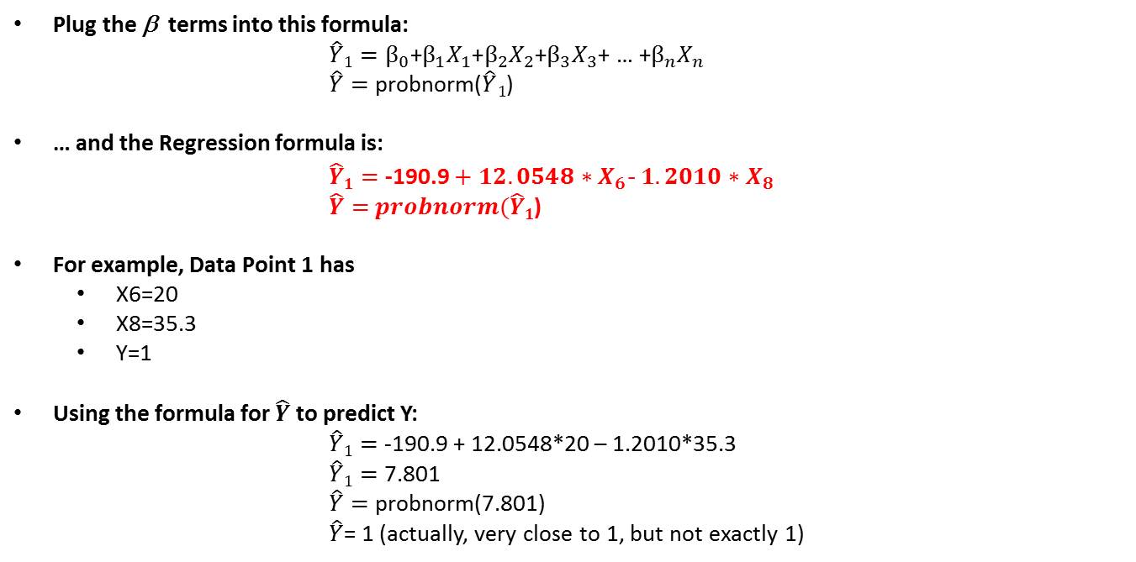
Probit Regression REF=“0”
Plug the β terms into this formula:
$\hat{Y}1=β_{0}$+$β_{1}X_{1}\text{+}β_{2}X_{2}$+$β_{3}X_{3}$+ … +$β_{n}X_{n}$
$\hat{Y}=$ probnorm($\hat{Y}1$)
… and the Regression formula is:
$\hat{Y}1=$ -190.9 $+ 12.0548{ ∗X}_{6}\text{−} 1.2010∗X_{8}$
$\hat{Y}=$ $probnorm(\hat{Y}1$)
For example, Data Point 1 has
X6=20
X8=35.3
Y=1
Using the formula for $\hat{Y}$ to predict Y:
$\hat{Y}1=$ -190.9 + 12.0548*20 – 1.2010*35.3
$\hat{Y}1=$ 7.801
$\hat{Y}=$ probnorm(7.801)
$\hat{Y}$= 1 (actually, very close to 1, but not exactly 1)

Slide 32
Probit Regression REF=“0”
A SAS Data Step can score new data using the results from the Regression. Here is what the Data Step might look like.
data NEWFILE;
set TEMPFILE;
TEMP = -190.9 + 12.0548*X6 – 1.2010*X8;
Y_Hat_Probit_0 = probnorm(TEMP);
drop TEMP;
run;
To use this Data Step, simply replace “TEMPFILE” with the name of your file. The results will be stored in a data set called “NEWFILE”.
This is simple enough, but to make this more general purpose, it would be easy to put this Data Step inside of a SAS Macro.

Slide 33
Probit Regression REF=“0”
The Data Step is now contained in a SAS Macro:
%macro SCORE( INFILE, OUTFILE );
data &OUTFILE.;
set &INFILE.;
TEMP = -190.9 + 12.0548*X6 – 1.2010*X8;
Y_Hat_Probit_0 = probnorm(TEMP);
drop TEMP;
run;
%mend;
When you call the SAS Macro, pass it the name of the data set and a name of a new data set where you want to store the results.
%SCORE( TEMPFILE, MY_NEW_FILE );

Slide 34
Probit Regression REF=“0”
The output of the proc print would be:
Obs | X6 | X8 | Y | Y_Hat_Probit_0
1 | 20 | 35.3 | 1 | 1
2 | 20 | 29.7 | 1 | 1
3 | 23 | 30.8 | 1 | 1
4 | 20 | 58.8 | 0 | 0
5 | 21 | 61.4 | 0 | 0
6 | 22 | 71.3 | 0 | 0
7 | 11 | 74.4 | 0 | 0
8 | 23 | 76.7 | 0 | 0
9 | 21 | 70.7 | 0 | 0
10 | 20 | 57.5 | 0 | 0
11 | 20 | 46.4 | 0 | 0
12 | 21 | 28.9 | 1 | 1
13 | 21 | 28.1 | 1 | 1
14 | 19 | 39.1 | 0 | 0
15 | 23 | 46.8 | 1 | 1
16 | 20 | 48.5 | 0 | 0
17 | 22 | 59.3 | 1 | 0.99899
18 | 22 | 70 | 0 | 0
19 | 11 | 70 | 0 | 0
20 | 23 | 74.5 | 0 | 0.00092
21 | 20 | 72.1 | 0 | 0
22 | 21 | 58.1 | 0 | 0
23 | 20 | 44.6 | 0 | 0.00038
24 | 20 | 33.4 | 1 | 1
25 | 22 | 28.6 | 1 | 1

Slide 35
Probit Regression REF=“0”
Now it is possible to predict the “Y” value for new input values. For example:
data SomeNewData;
input X6 X8;
datalines;
15 25
20 35
25 45
30 50
35 55
;
run;
%SCORE(SomeNewData, NowItsScored );
proc print data=NowItsScored;
run;

Slide 36
Probit Regression REF=“0”
The output of the proc print would be:
Obs | X6 | X8 | Y_Hat_Probit_0
1 | 15 | 25 | 0
2 | 20 | 35 | 1
3 | 25 | 45 | 1
4 | 30 | 50 | 1
5 | 35 | 55 | 1

Slide 37
All Three Scores
All Three Examples in One Macro

Slide 38
All Three Examples in One Macro
The Data Step with all three scores is now contained in a SAS Macro:
%macro SCORE( INFILE, OUTFILE );
data &OUTFILE.;
set &INFILE.;
* Calculate Prob of Y=1 from LOGIT Reference="0";
TEMP = -327.0 + 20.5993*X6 - 2.0414*X8;
TEMP = exp(TEMP);
TEMP = TEMP / (1.0+TEMP);
Y_Hat_Logit_0 = TEMP;
/** Calculate Prob of Y=1 from LOGIT Reference="1";*/
TEMP = 210.6 + -13.2155*X6 + 1.2996*X8;
TEMP = exp(TEMP);
TEMP = TEMP / (1.0+TEMP);
Y_Hat_Logit_1 = 1-TEMP;
/** Calculate Prob of Y=1 from PROBIT Reference="0";*/
TEMP = -190.9 + 12.0548*X6 - 1.2010*X8;
Y_Hat_Probit_0 = probnorm(TEMP);
drop TEMP;
run;
%mend;

Slide 39
All Three Examples in One Macro
The output of the proc print would be:
Obs | X6 | X8 | Y | Y_Hat_Logit_0 | Y_Hat_Logit_1 | Y_Hat_Probit_0
1 | 20 | 35.3 | 1 | 1 | 0.9996 | 1
2 | 20 | 29.7 | 1 | 1 | 1 | 1
3 | 23 | 30.8 | 1 | 1 | 1 | 1
4 | 20 | 58.8 | 0 | 0 | 0 | 0
5 | 21 | 61.4 | 0 | 0 | 0 | 0
6 | 22 | 71.3 | 0 | 0 | 0 | 0
7 | 11 | 74.4 | 0 | 0 | 0 | 0
8 | 23 | 76.7 | 0 | 0.00006 | 0.00179 | 0
9 | 21 | 70.7 | 0 | 0 | 0 | 0
10 | 20 | 57.5 | 0 | 0 | 0 | 0
11 | 20 | 46.4 | 0 | 0.00006 | 0.00137 | 0
12 | 21 | 28.9 | 1 | 1 | 1 | 1
13 | 21 | 28.1 | 1 | 1 | 1 | 1
14 | 19 | 39.1 | 0 | 0 | 0.00003 | 0
15 | 23 | 46.8 | 1 | 1 | 1 | 1
16 | 20 | 48.5 | 0 | 0 | 0.00009 | 0
17 | 22 | 59.3 | 1 | 0.99412 | 0.95584 | 0.99899
18 | 22 | 70 | 0 | 0 | 0.00002 | 0
19 | 11 | 70 | 0 | 0 | 0 | 0
20 | 23 | 74.5 | 0 | 0.00496 | 0.03036 | 0.00092
21 | 20 | 72.1 | 0 | 0 | 0 | 0
22 | 21 | 58.1 | 0 | 0 | 0.00019 | 0
23 | 20 | 44.6 | 0 | 0.00233 | 0.01403 | 0.00038
24 | 20 | 33.4 | 1 | 1 | 0.99997 | 1
25 | 22 | 28.6 | 1 | 1 | 1 | 1

Slide 40
All Three Examples in One Macro
Now it is possible to predict the “Y” value for new input values. For example:
data SomeNewData;
input X6 X8;
datalines;
15 25
20 35
25 45
30 50
35 55
;
run;
%SCORE(SomeNewData, NowItsScored );
proc print data=NowItsScored;
run;

Slide 41
All Three Examples in One Macro
The output of the proc print would be:
Obs | X6 | X8 | Y_Hat_Logit_0 | Y_Hat_Logit_1 | Y_Hat_Probit_0
1 | 15 | 25 | 0 | 0 | 0
2 | 20 | 35 | 1 | 0.99973 | 1
3 | 25 | 45 | 1 | 1 | 1
4 | 30 | 50 | 1 | 1 | 1
5 | 35 | 55 | 1 | 1 | 1

Slide 42
Good Idea
Safety Tip !

Slide 43
Safety Tip
In some computer languages (including SAS), problems can occur with large numbers. Refer back to the data step for the logistic regression.
data NEWFILE;
set TEMPFILE;
TEMP = -327 + 20.5993*X6 – 2.0414*X8;
TEMP = exp( TEMP );
TEMP = TEMP / (1.0+TEMP);
Y_Hat_Logit_0 = TEMP;
drop TEMP;
run;

Slide 44
Safety Tip
It is possible for the value of “TEMP” to become large if the value of X6 is large enough. Probably unlikely in this case, but theoretically possible.
data NEWFILE;
set TEMPFILE;
TEMP = -327 + 20.5993*X6 – 2.0414*X8;
TEMP = exp( TEMP );
TEMP = TEMP / (1.0+TEMP);
Y_Hat_Logit_0 = TEMP;
drop TEMP;
run;

Slide 45
Safety Tip
When SAS takes an exponent of a very large number that it cannot handle, it returns a “missing” value. Thus, the Y_Hat_Logit_0 will be “missing”.
data NEWFILE;
set TEMPFILE;
TEMP = -327 + 20.5993*X6 – 2.0414*X8;
TEMP = exp( TEMP );
TEMP = TEMP / (1.0+TEMP);
Y_Hat_Logit_0 = TEMP;
drop TEMP;
run;

Slide 46
Safety Tip
One approach to dealing with this possibility is to include a check for a missing value and then handle the condition. There are two places to do this:
data NEWFILE;
set TEMPFILE;
TEMP = -327 + 20.5993*X6 – 2.0414*X8;
TEMP = exp( TEMP );
TEMP = TEMP / (1.0+TEMP);
Y_Hat_Logit_0 = TEMP;
drop TEMP;
run;

Slide 47
Safety Tip
Here:
data NEWFILE;
set TEMPFILE;
TEMP = -327 + 20.5993*X6 – 2.0414*X8;
TEMP = exp( TEMP );
if missing(TEMP) then TEMP = 99999;
TEMP = TEMP / (1.0+TEMP);
Y_Hat_Logit_0 = TEMP;
drop TEMP;
run;

Slide 48
Safety Tip
…. Or here. (Either one would work).
data NEWFILE;
set TEMPFILE;
TEMP = -327 + 20.5993*X6 – 2.0414*X8;
TEMP = exp( TEMP );
TEMP = TEMP / (1.0+TEMP);
Y_Hat_Logit_0 = TEMP;
if missing(Y_Hat_Logit_0) then Y_Hat_Logit_0 = 1;
drop TEMP;
run;

